Slide 1

Leadership for sustainable open source research software organizations
Second URSSI Workshop
October 23, 2018
Dan Sholler - rOpenSci project - @DanSholler

Slide 2
Unique organizational characteristics

Slide 3
How do leaders emerge?

Slide 4
Democratically, via technical contributions
Eric von Hippel, Georg von Krogh, (2003) Open Source Software and the “Private-Collective” Innovation Model: Issues for Organization Science. Organization Science 14(2):209-223. https://doi.org/10.1287/orsc.14.2.209.14992

Slide 5
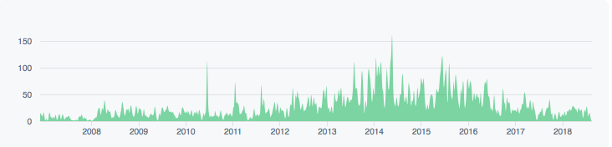
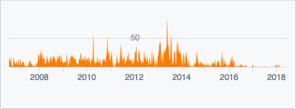

Slide 6
Transitioning to administrative tasks
Securing funding
Developing standards and SOPs
Strategy and direction

Slide 7
Learning leadership and managerial skills
“I read books.”
“I learned to just triage, and how to signal what’s important.”

Slide 8
How can we support the development of administrative, managerial skills to sustain leadership?

Slide 9
Acknowledgments
Work funded by the Leona M. and Harry B. Helmsley Charitable Trust
Special thanks to the interview participants
Research conducted under UC Berkeley Office for the Protection of Human Subjects Protocol ID 2017-08-10194

